Slide 1


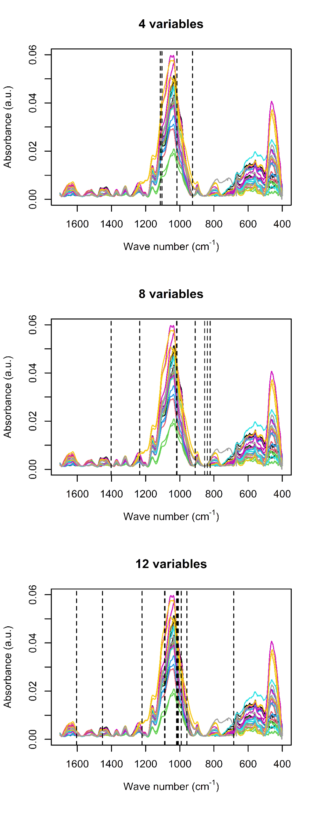
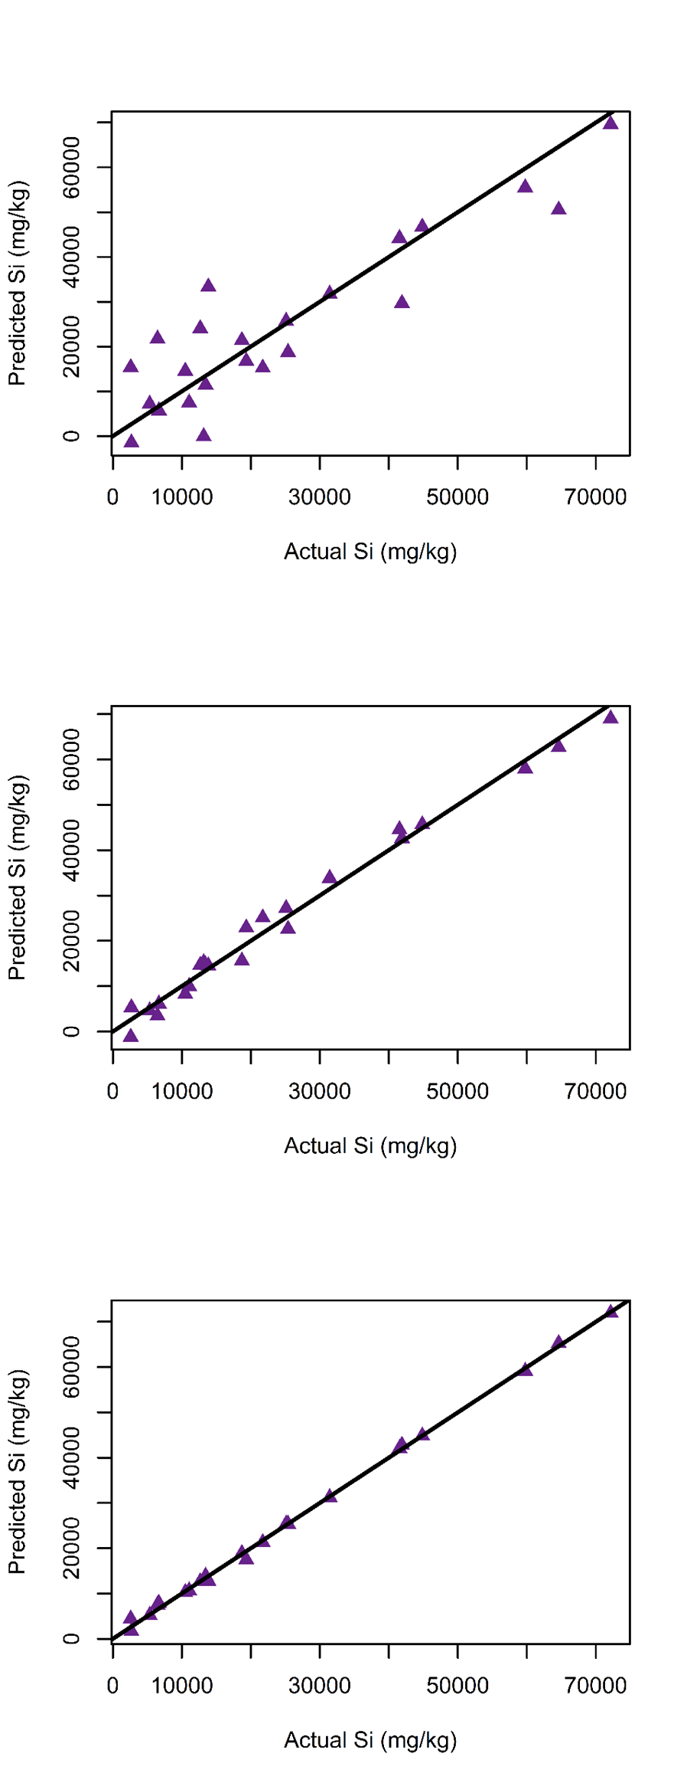

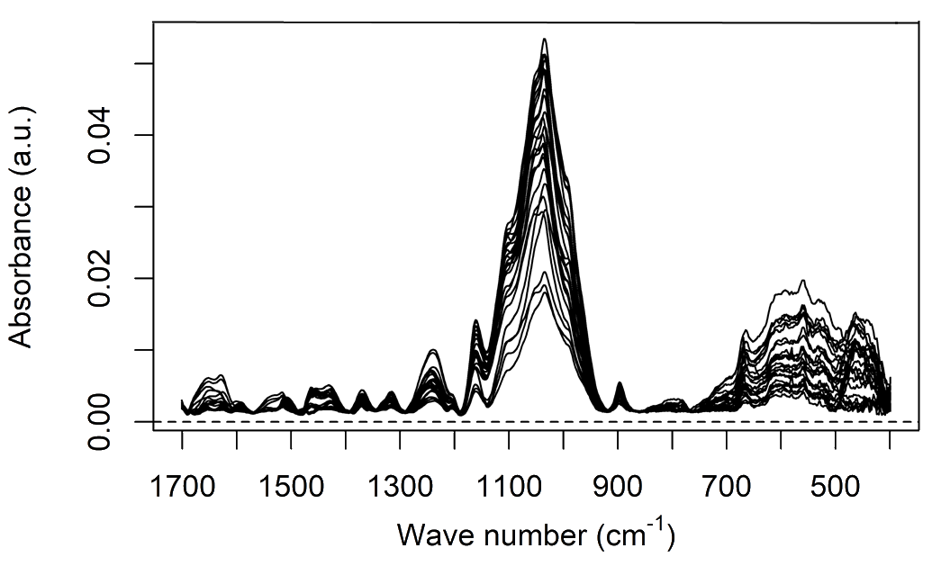






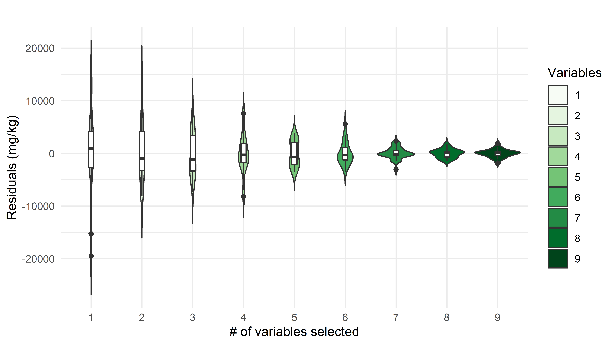

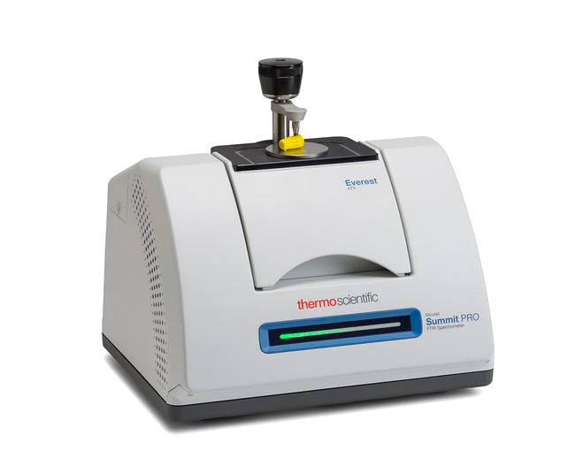
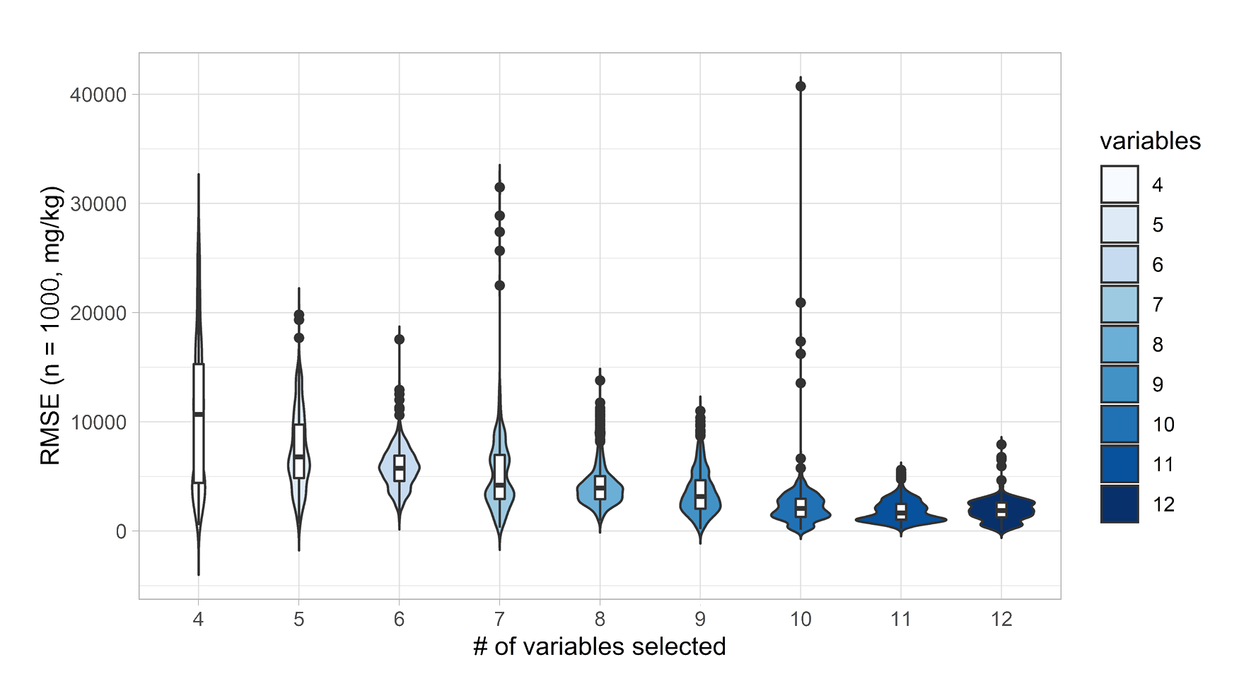

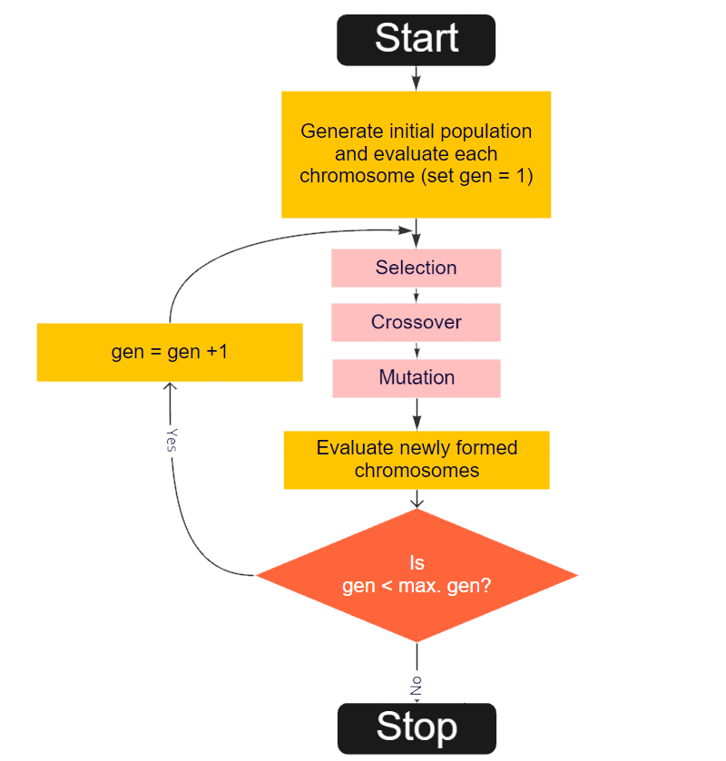
34
20
3
4
20
CONGRESO LATINOAMERICANO DE QUÍMICA
CARTAGENA DE INDIAS - COLOMBIA
CARTAGENA DE INDIAS - COLOMBIA
Determination of Silicon in Wheat Leaves with ATR-FTIR and Chemometrics
Andrés Beltrán¹; Andrés Cabrera¹, Yohanna Cabrera²
¹ LICE, Departamento de Química, Facultad de Ciencias, Universidad Nacional de Colombia, Bogotá (Colombia)
² Department of Geosciences and Natural Resource Management Forest, Nature and Biomass, university of Copenhagen (Dinamarca)
Results
GA-Selected variables
Introduction
The beneficial effects of silicon for plants have been noticed for more than a century, but only during the last two decades has its role in high productivity agriculture systems been thoroughly studied. The presence of silicon in plants contributes stress-relief mechanisms for environmental events such as drought and pathogen attack. Because of the importance of crops such as wheat, barley, rice, and other grasses that accumulate Si, understanding the relationship between this element and plant science is the focus of numerous scientific efforts. Si quantification is a difficult and costly task, and destructive wet chemistry methods are commonly used. With the recent development of chemometric tools, analysis of silicon in complex matrices have has been proved feasible.
Methods
Three groups of wheat plants were cultivated using both greenhouse and controlled growing chambers in hydroponic beds. These groups were different by their silicon supply, which was through NaSiO3. Samples from the leaves of plants from all three groups were analyzed using ATR-FTIR, spectra were pre-processed by calculating the mean of three samples and performing a baseline correction.
Regression models
Baseline correction
Variable
selection
Si
Cross-validation and prediction
Model assessment and performance criteria evaluation
GA- Selected variables model
1 |  | 5 |  | 9
Model F test p-value | 1.513e-06 | Model F test p-value | 1.135e-11 | Model F test p-value | 2.424e-12
Adjusted R squared | 0.7823 | Adjusted R squared | 0.9782 | Adjusted R squared | 0.9965
Variable (cm⁻¹) | P value | Variable (cm⁻¹) | P value | Variable (cm⁻¹) | P value
Intercept | 1.43e-02 | Intercept | 6.1e-04 | Intercept | 7.20e-10
925.679 | 4.88e-05 | 821.54 | 2.96e-10 | 684.617 | 1.77e-06
1016.32 | 4.66e-07 | 838.896 | 6.60e-10 | 958.463 | 9.69e-06
1105.03 | 2.84e-07 | 854.324 | 4.30e-07 | 991.248 | 2.27e-06
1114.67 | 1.42e-06 | 910.251 | 2.75e-08 | 1008.6 | 6.92e-08
- | - | 1016.32 | 5.30e-12 | 1012.46 | 1.83e-07
- | - | 1018.25 | 5.13e-12 | 1014.39 | 4.29e-10
- | - | 1234.24 | 4.55e-03 | 1018.25 | 1.35e-10
- | - | 1402.02 | 2.47e-05 | 1085.74 | 1.91e-10
- | - | - | - | 1089.6 | 1.85e-10
- | - | - | - | 1220.74 | 2.46e-07
- | - | - | - | 1452.16 | 7.34e-07
- | - | - | - | 1604.51 | 3.26e-03
Greenhouse
Experiment
Spectra acquisition
Figure #: Distribution of residuals vs model complexity
Data Analysis
Preprocessing
Modelling
Prediction
validation
Figure #: Cross validated error of prediction vs model complexity
Conclusion
References
[1] Chen, H., Ferrari, C., Angiuli, M., Yao, J., Raspi, C., & Bramanti, E. (2010). Qualitative and quantitative analysis of wood samples by Fourier transform infrared spectroscopy and multivariate analysis. Carbohydrate polymers, 82(3), 772-778.
[2] Varmuza, K., & Filzmoser, P. Introduction to multivariate statistical analysis in chemometrics. CRC press, 2016.
34
20
Diagram #: Genetic algorithm for variable selection
3
4
20
CONGRESO LATINOAMERICANO DE QUÍMICA
CARTAGENA DE INDIAS - COLOMBIA
CARTAGENA DE INDIAS - COLOMBIA

